Slide 1
One More Night with the Frogs
Making a Decision for Christ Today

Slide 2
Exodus 8:8 Then Pharaoh summoned Moses and Aaron and begged, “Plead with the Lord to take the frogs away from me and my people. I will let your people go, so they can offer sacrifices to the Lord.”
⁹ “You set the time!” Moses replied. “Tell me when you want me to pray for you, your officials, and your people. Then you and your houses will be rid of the frogs. They will remain only in the Nile River.”

Slide 3
Exodus 8:10 “Do it tomorrow,” Pharaoh said.

Slide 4
That’s just me.
I can’t change.
I’ve tried.
No one is perfect.
It’s impossible.
You don’t know my family history.

Slide 5
Two extremes in holiness:
1. You must change so God can love you.
2. God loves you, so no need to change.

Slide 6
Decision Time
What doesn’t work.

Slide 7
Experience
Promise
Place
Threats
Shame

Slide 8
Resist three temptations:
Bury.
Blame.
Bye.

Slide 9
Decision Time
2. What works.

Slide 10
1. A clear vision of who God is and who you are.

Slide 11
Matthew 19:26
Jesus looked at them intently and said, “Humanly speaking, it is impossible. But with God everything is possible.”

Slide 12
Exodus 14:13 But Moses told the people, “Don’t be afraid. Just stand still and watch the Lord rescue you today. The Egyptians you see today will never be seen again. ¹⁴ The Lord himself will fight for you. Just stay calm.”

Slide 13
Trust the process.

Slide 14
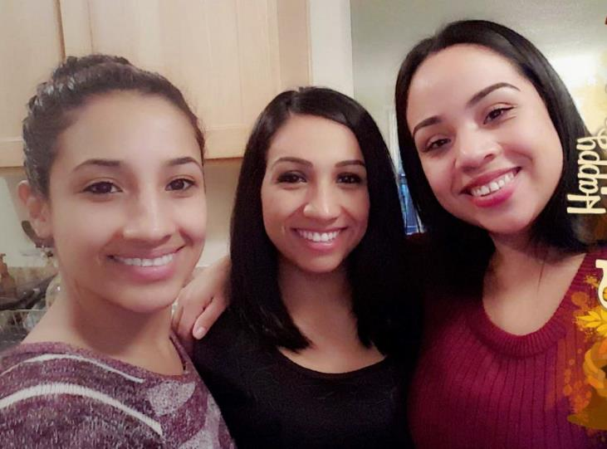

Slide 15
2. Re-think

Slide 16
^{Exodus 14:10} As Pharaoh approached, the people of Israel looked up and panicked when they saw the Egyptians overtaking them. They cried out to the Lord,

Slide 17
“For though we live in the world, we do not wage war as the world does. The weapons we fight with are not the weapons of the world. On the contrary, they have divine power to demolish strongholds” (2 Cor. 10: 3 – 4).

Slide 18
The Greek word translated as strongholds is ochuroma (pronounced oak-EW-ROH-muh), which means to fortify, lock up, or imprison.
Groeschel, Craig; Groeschel, Craig. The Christian Atheist: When You Believe in God But Live as if He Doesn’t Exist (p. 128). Zondervan. Kindle Edition.

Slide 19
Both of my parents are heavy, so I’ll always struggle with my weight.
I’m just not good with money. I’ll always be in debt.
Some people are positive people. I’m not. I’m just naturally critical and negative.
When you feel bad about yourself and start sliding into those all-too-familiar thoughts.
Groeschel, Craig; Groeschel, Craig. The Christian Atheist: When You Believe in God But Live as if He Doesn’t Exist (pp. 136-137). Zondervan. Kindle Edition.

Slide 20
3. Surrender.

Slide 21
The biblical evidence is clear about making a decision sooner rather than later:
1. John the Baptist- Mathew 3
2. Pentecost- Acts 2:38
3. Philip and the Eunuch- Acts 8
4. Philippian Jailer- Acts 16
5. Lydia- Acts 16
6. Disciples- Acts 19

Slide 22
10 Reasons

Slide 23
Mathew 3:16 After his baptism, as Jesus came up out of the water, the heavens were opened and he saw the Spirit of God descending like a dove and settling on him. ¹⁷ And a voice from heaven said, “This is my dearly loved Son, who brings me great joy.”

Slide 24
What the heart most wants the mind finds reasonable, the emotions find valuable, and the will finds doable.
Keller, Timothy (2015-06-09). Preaching: Communicating Faith in an Age of Skepticism (Kindle Locations 1955-1956). Penguin Publishing Group. Kindle Edition.

Slide 25
I decided.

